Slide 1
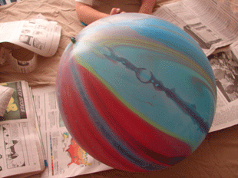
Step 1
Blow up the balloon, and tie off the end.

Slide 2
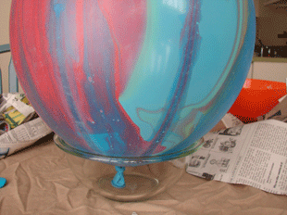
Step 2
To keep the balloon steady, you can use
a small mixing bowl as a base. Tape if
necessary.

Slide 3
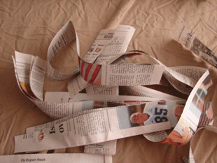
Step 3
Cut up a pile of newspaper strips. I like them longer better so I cut vertically

Slide 4
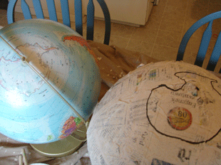
Step 4
With a lead pencil draw in the continents, but first draw a line around the centre for the Equator.

Slide 5
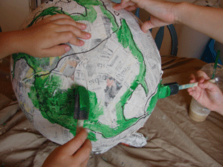
Step 5
Now for the fun! Start to paint your continents GREEN

Slide 6
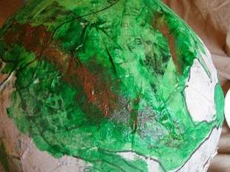
Step 6
Go through each continent and paint in some Mountains (BROWN) where ever the children feel them.

Slide 7
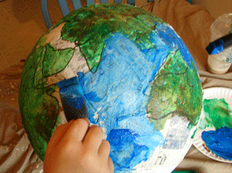
Step 7
Now it's time for the oceans! Mix up some BLUE paint and fill in the rest! Both colours are going to need a couple of coats of paint so you don’t see the newspaper underneath.

